Slide 1
Fire Phoenix
An advance fire disaster management system

Slide 2
TABLE OF CONTENTS
01
02
03
04
Basic Idea representation
Equipment list
Demo of the robot
Features of the whole system

Slide 3
INTRODUCTION
Introducing the “Fire Phoenix” – a comprehensive and innovative solution designed to enhance fire incident response and control. This advanced system seamlessly integrates user-friendly mobile applications, an efficient admin panel for web-based operations, and a cutting-edge fire-fighting robot to tackle emergencies effectively and swiftly.

Slide 4
01
Basic Idea
Let’s see what are the basic thoughts of us about this project

Slide 5
CONCEPTS
Mobile Application
The system has an user friendly mobile application fo the users
Admin Panel
A dedicated web based admin panel to control data flow and the robot control
Fire fighting robot
A visual fire fighting robot to control the on site activities

Slide 6
02
Equipment List
The required equipments for this project

Slide 7
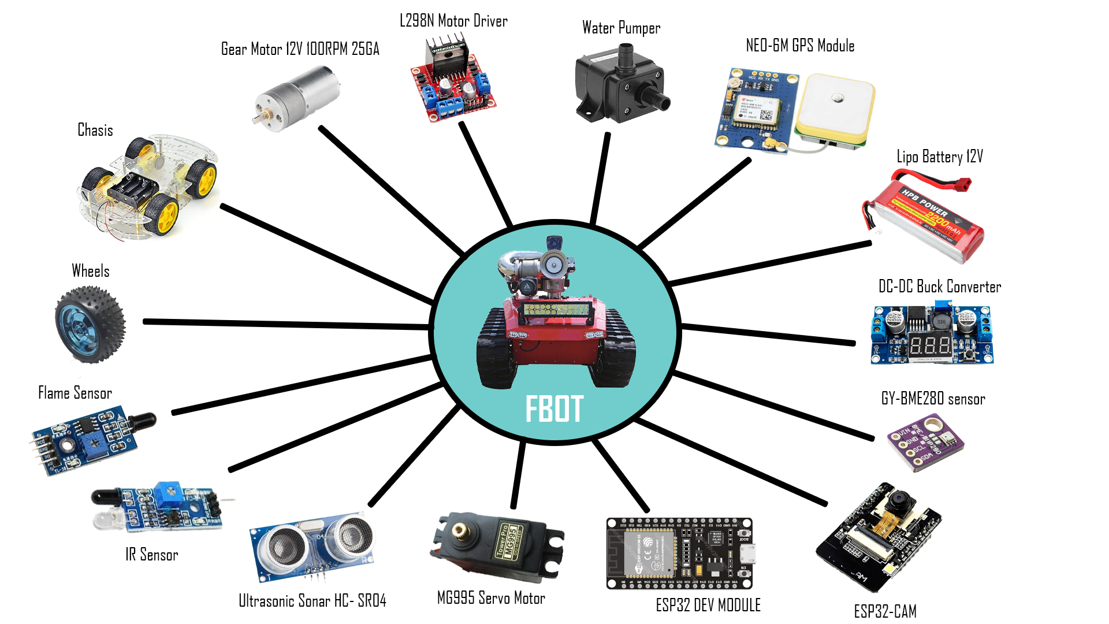

Slide 8
03
Demo of the robot
The demo robot of the system

Slide 9
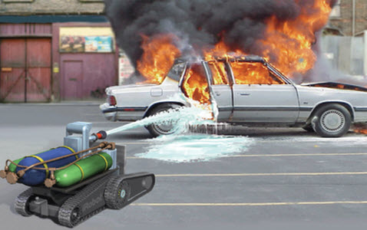
The Demo robot
This robot is our main focus which is controlled by the admin panel and capable of handling the on site situation manually or automatically with the help of machine learning algorithms

Slide 10
04
Features of the system
The key features of the system is described

Slide 11
Features of the System
Real Time incident reporting
Alerts and notification about the fire
Geolocation services
Autonomous robot operation
Remote robot control by admin panel
Search and rescue capabilities
Education and training on fire safety via mobile application
Data analytics
Multi platform support

Slide 12
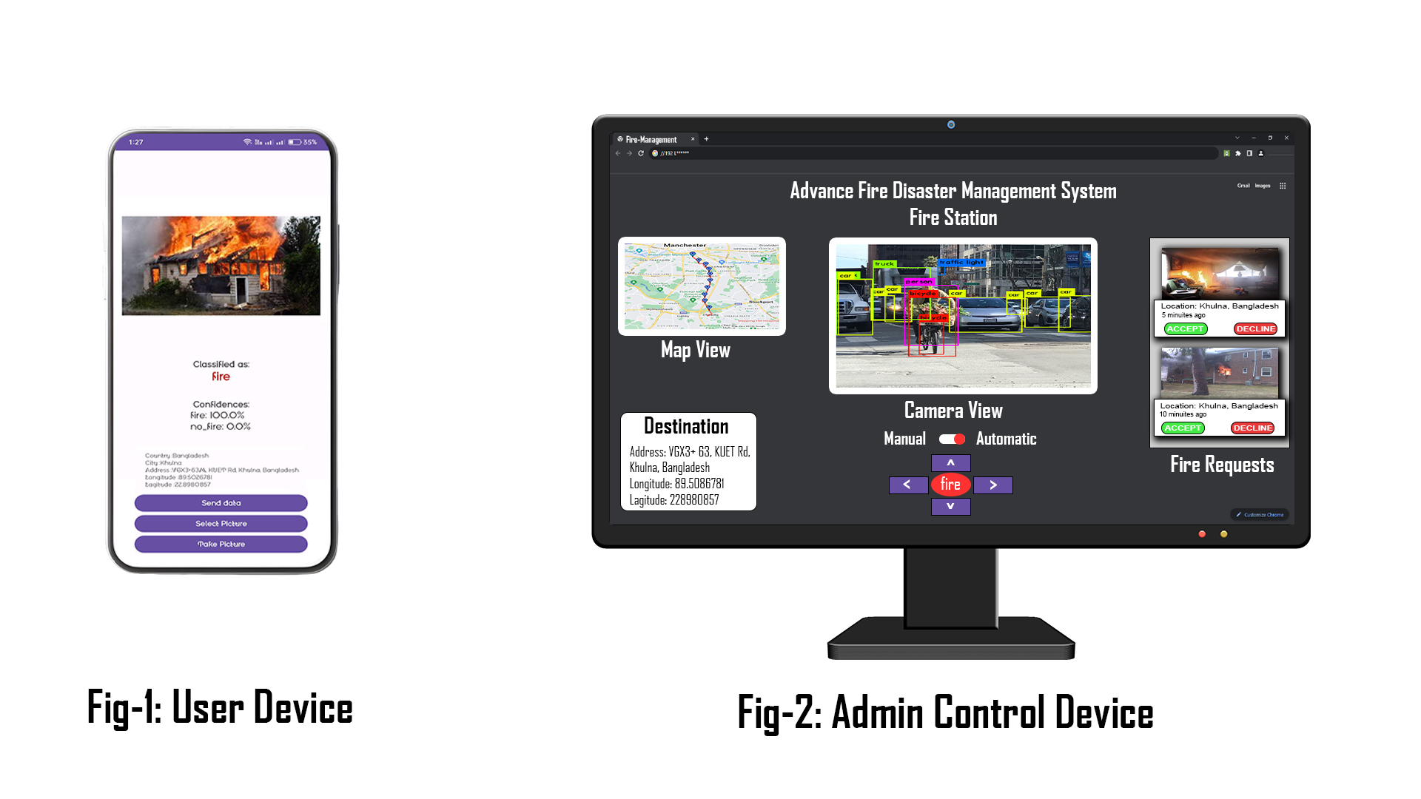

Slide 13
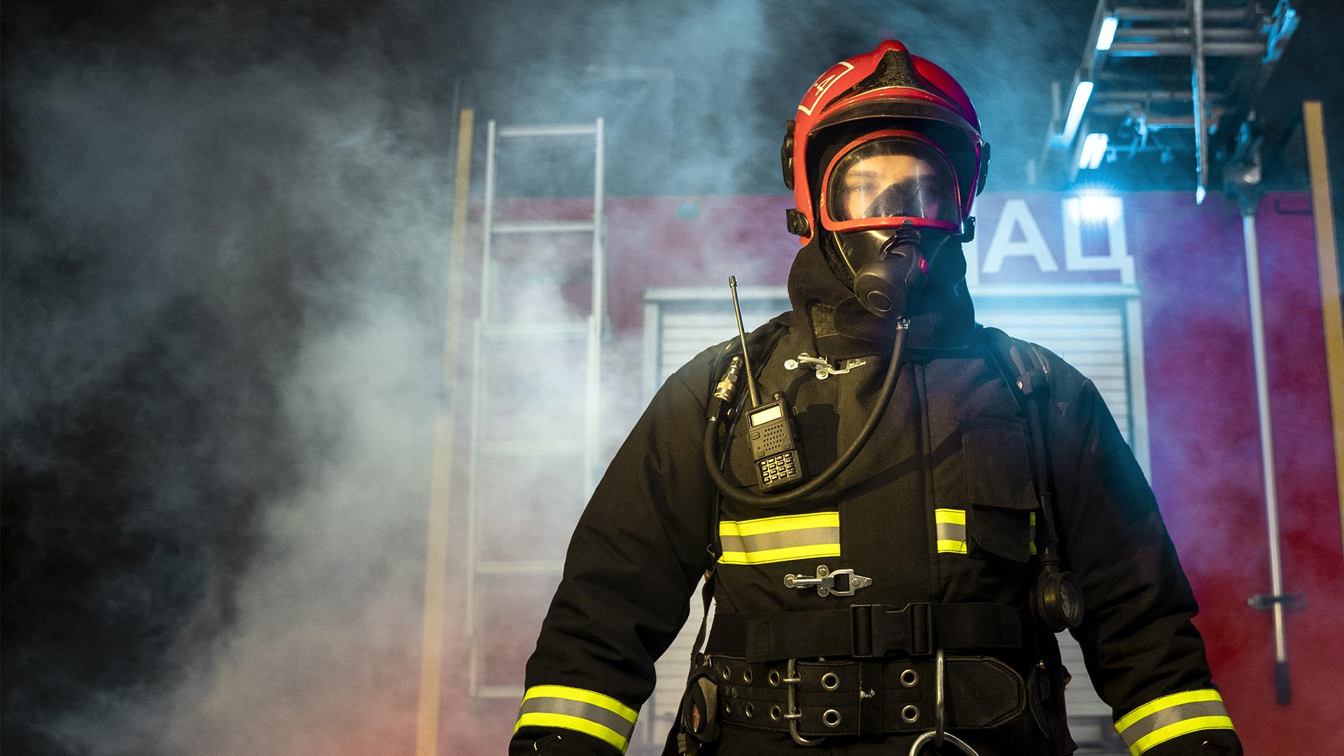
So
We are your rescuer

Slide 14
THANKS!
Do you have any questions?
Md. Masudur Rahman Rabby
01840794147
George Tonmoy Roy
01828113846

